Slide 1
Web Project
VOUTERS Florian– GILLY Pierre – MAISANO Robin

Slide 2
Summary
Project Presentation
How does project basically works
View explanation (Robin)
Controller explanation (Florian)
Model explanation (Pierre)
Project Organization (Tasks & Repartition)
Conclusion
Questions

Slide 3

Project Presentation
Develop a new website for the BDE of the CESI :
Online Shop
Activities and ideas
Comment the events
Project Presentation
Controller explanation
Model explanation
Conclusion
Questions
Project Organization
How does project basically works
View explanation

Slide 4
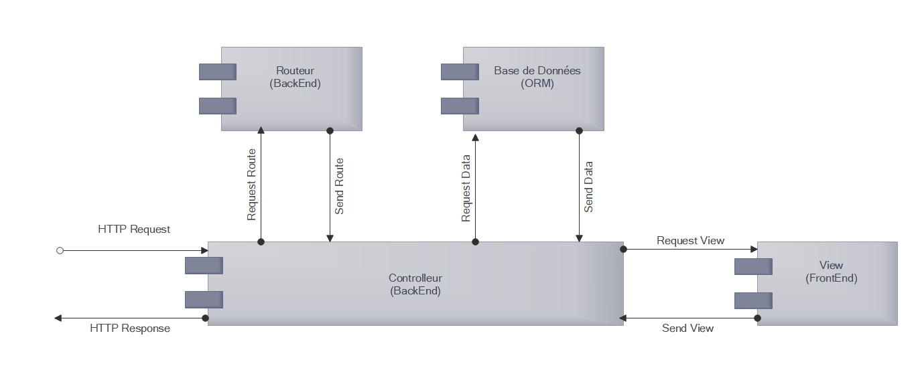
How does project works
The main 3 parts:
Model
View
Controller
Project Presentation
Controller explanation
Model explanation
Conclusion
Questions
Project Organization
How does project basically works
View explanation

Slide 5
View explanation What is the view?
Connection between user and the rest of the website
Allow user to act – to « do things »
Permit the website to have a dynamical aspect
Project Presentation
Controller explanation
Model explanation
Conclusion
Questions
Project Organization
How does project basically works
View explanation

Slide 6
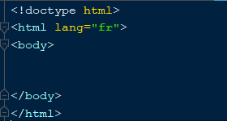

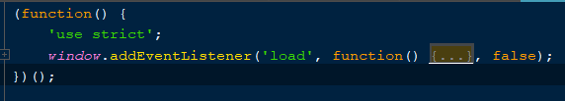
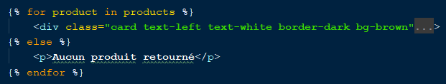
View explanation How does it work?
HTML
CSS
Made with Html – CSS – JavaScript
Html = Tag Langage
CSS = Style
JavaScript = Code to react
TWIG to transform before display
JavaScript
TWIG
Project Presentation
Controller explanation
Model explanation
Conclusion
Questions
Project Organization
How does project basically works
View explanation

Slide 7
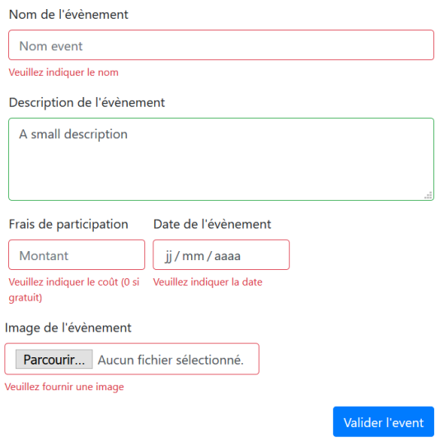
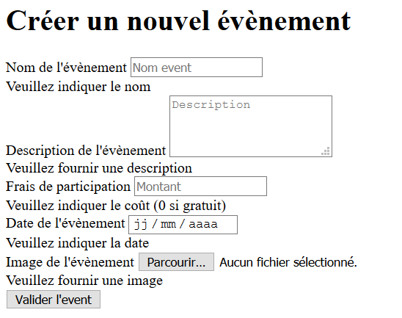
View explanation Why is it important?
Without the view, nothing will be displayed on the web browser
Without style, website will look like console application
Permit dynamical aspect and reaction
Project Presentation
Controller explanation
Model explanation
Conclusion
Questions
Project Organization
How does project basically works
View explanation

Slide 8
Controller explanation What is the controller?
The controller assembles data from the Database to retrieve on the view
It gives the real route on each controller who manage data
It calculate all data from the database to give to the visitor what he is looking for
Project Presentation
View explanation
Controller explanation
Model explanation
Conclusion
Questions
Project Organization
How does project basically works

Slide 9
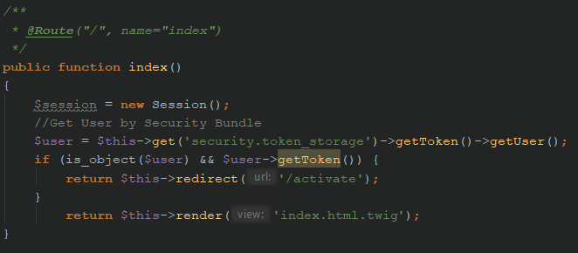
Controller explanation How does it works?
Each route request:
Take elements from Model
Pass it through tests
Order model to update the element position
Order view to update itself
Project Presentation
View explanation
Controller explanation
Model explanation
Conclusion
Questions
Project Organization
How does project basically works
Notes:
Game loop continue until player wins or loses
React when player press a key

Slide 10
Controller explanation Why is it important?
Make every components communicate together
Gives order to components
Gives to the view part what to display
Project Presentation
View explanation
Controller explanation
Model explanation
Conclusion
Questions
Project Organization
How does project basically works

Slide 11
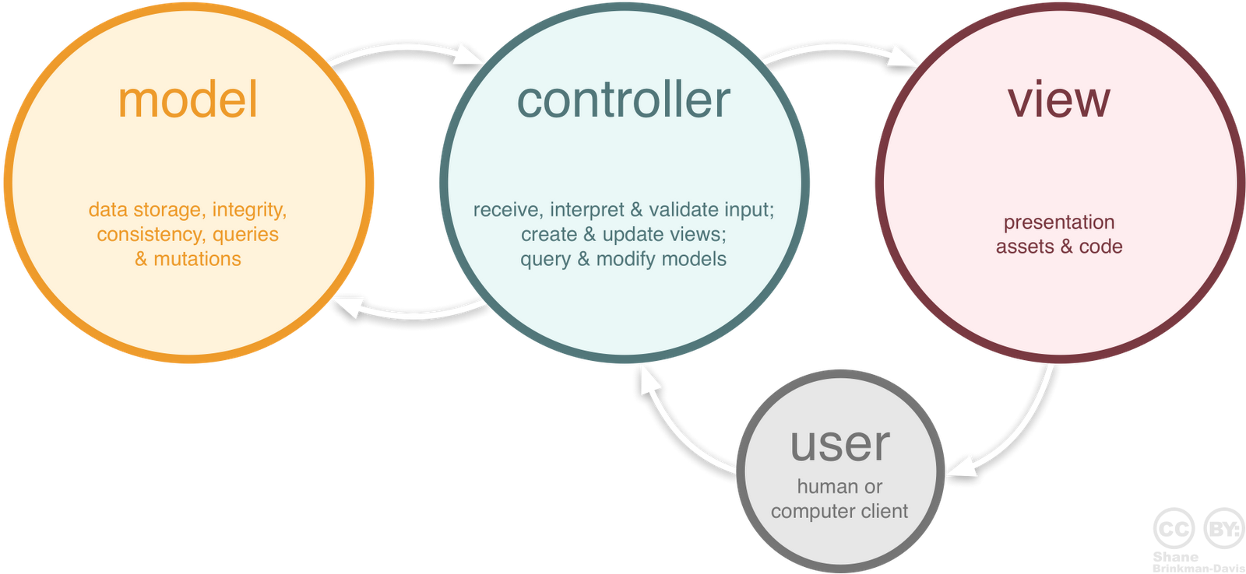
Model explanation What is the model?
Model
Storage
ORM
Database
Objects
Query
Project Presentation
View explanation
Controller explanation
Model explanation
Conclusion
Questions
Project Organization
How does project basically works
Notes:
It allow the controller to acces to data and modify them It’s divided in 2 parts : the database and the ORM (object-relational mapping) - The ORM allow the developper to simplify his work because he doesn’t have to make any SQL langage. Instead he can develop his DB with PHP language. It’s much easier. Morehower it allow the developper to think and manipulate data like an object and not like a simple line in a table

Slide 12
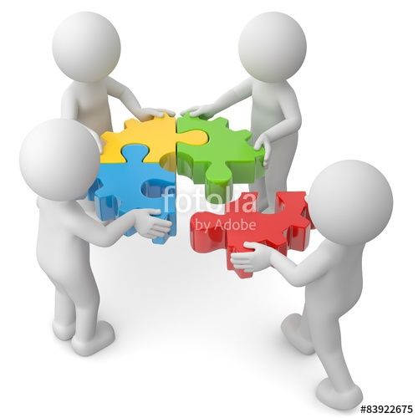
Model explanation How does it work?
Model
Database
Entity
Repository
Controller
Project Presentation
View explanation
Controller explanation
Model explanation
Conclusion
Questions
Project Organization
How does project basically works
Notes:
The mains 4 part are this part : Database is the DB with the tables and attribute Entity are the class in PHP wo will create the db further. The entity includes the the attributes in php with the getter and setter

Slide 13

Model explanation Why it’s important?
Entities
Comments
Users
Products
Baskets
Activities
Project Presentation
View explanation
Controller explanation
Model explanation
Conclusion
Questions
Project Organization
How does project basically works
Notes:
It a big important part because it includes and defines all the data wo will be used in the program . With out him there will be

Slide 14
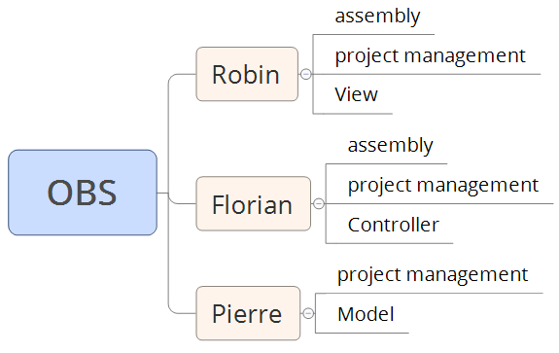
Project Organization Tasks & Repartition
Project Presentation
View explanation
Controller explanation
Model explanation
Conclusion
Questions
Project Organization
How does project basically works

Slide 15
Conclusion Results
Project Presentation
View explanation
Controller explanation
Model explanation
Conclusion
Questions
Project Organization
How does project basically works

Slide 16
Questions
Thank you for your attention. We will be pleased to answer any question you have.

